Slide 1
Data Science vs Data Analyst

Slide 2
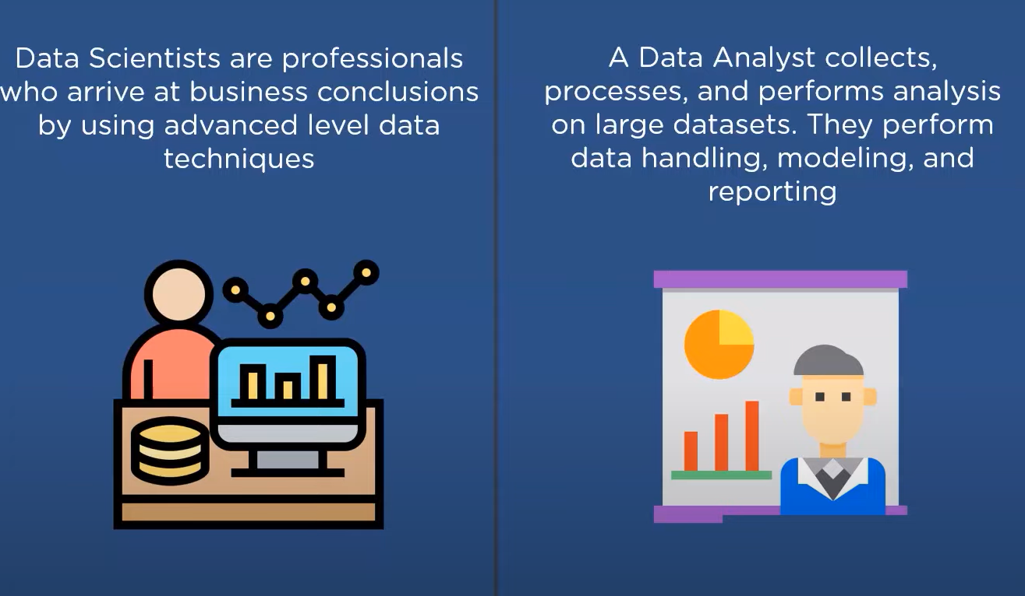
Overview

Slide 3
Data Science

Slide 4
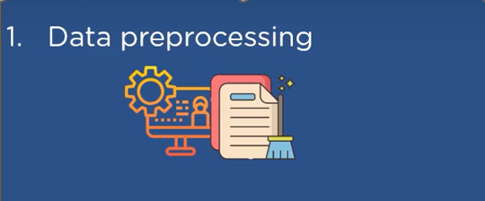
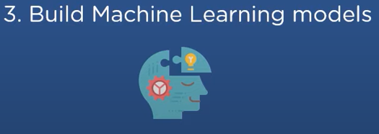
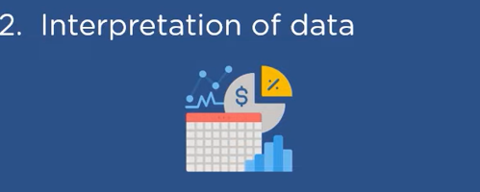

Responsibilities

Slide 5
Responsibilities
Understand and analyze data for deriving a business conclusion
Proactively fetching information from different data sources for completing data analysis and data manipulation
Building AI tools to automate business processes
Working with various data structures – structural/unstructured
Data scientists consider more advanced people in a team

Slide 6
Responsibilities
Data processing
Cleaning / Processing and Analysing Data / Ad hoc data mining of structural /unstructured data
Interpretation of Data
Using various data modeling techniques to present data insight
Building Machine learning and statistical algorithm
Data Visualization / Reports
Working with internal team members

Slide 7
Skills
Education – BA/ MS in Computer science
Good experience in analysis and data manipulation
Tools – Excel
Programming - Python / Java / Perl etc
Platform – Docker
Big Data - Hadoop / Apache Spike

Slide 8
Skills
Data Visualisation: Power BI / Tableau
Databases – Relation / Non Relation
Machine Learning
Microservices / API
Communication Skills - Working in a data science / it team
Cloud Skills

Slide 9
Data Analyst

Slide 10
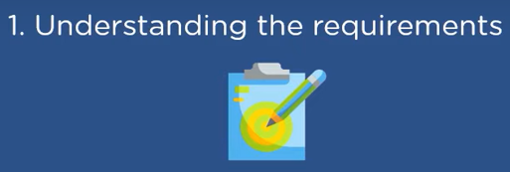

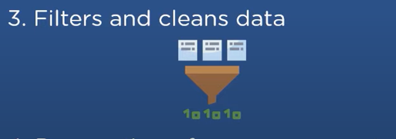
Responsibilities

Slide 11
Responsibilities
Understanding client requirements
Understand the business problem
Define resources that will be used
Collect/ process and analyze data
Gathering information from different data sources by using querying techniques

Slide 12
Responsibilities
Filtering and Cleaning Data
Data Handling
Data Modeling
Reporting
Consider an entry-level position for the data analytical team
Identifying patterns/trends
Preparing Summary report for the leadership team and external stakeholders

Slide 13
Skills
Education – Bachelor’s Degree in
Information technology / Computer Science / Statistics / Economics
Data Bases - SQL / Store Procedures / Triggers / Events
Machine Learning
Probability Distribution / Prediction/ Classification /Clustering
Programming - Python / R / Java Script
Statistical Tools - Excel / SAS

Slide 14
Skills
Describe data trends and anomalies
Storytelling techniques
Power BI / Tableau
Presentation / Public speaking skills
Visually Appealing Dashboards
Working with external /internal stakeholders

Slide 15
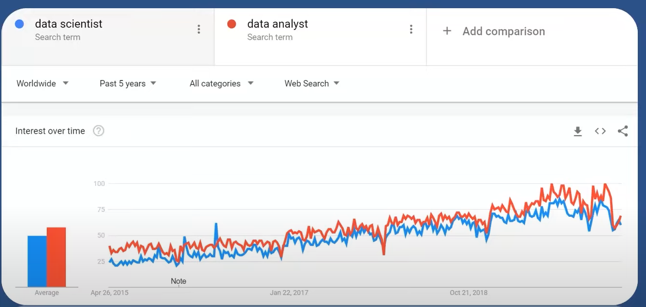
Trend

